Slide 1
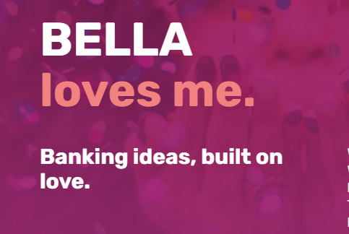
Product training

Slide 2
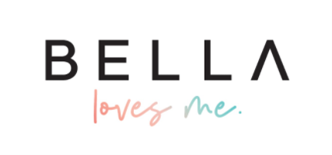
What’s Bella Loves Me?
Bella is a digital banking service built on Socratex, a brand new conversational technology.
BELLA is working to establish programs to benefit the BELLA community and world at large with messages of beauty, love, and tenderness at their cores.

Slide 3
OUR VALUES
Innovation
We never give up seeking creative solutions for our members
Intensity
We value people who go above and beyond.
Empathy
We understand that there are different perspectives and that we do not always know what kind of day people are having.
Equality
We value, respect and love people of all backgrounds, ethnicities, sexual orientation, race and gender.

Slide 4
What do I need to be a part of Bella.
– First and Last Name
– Permanent Residential Address
– US Mobile Phone Number
– Email
– Date of Birth (DOB)
– Social Security Number (SSN)
– US Residents.

Slide 5
ONBOARDING

Slide 6
What does Bella offer?
– No monthly maintenance fees, no minimum balance requirements.
– Unlimited savings accounts with a competitive interest rate.
Conventional and Unconventional rules to help build savings
– Karma accounts and Surprise Cashback programs that put money back in the member community.
– Live, US based customer service 24 hours a day, 7 days a week.

Slide 7
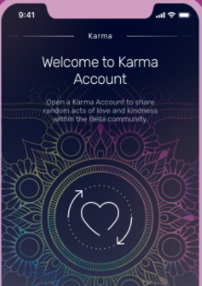
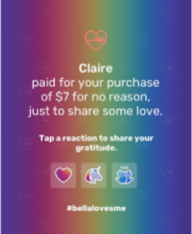
BLINK – KARMA
It’s a special bank account within BELLA used to surprise other random BELLA members with gifts like a cup of coffee or a tank of gas, and completely out of the blue.
Specs:
No cost to open and no minimum.
Max, of $20.00
Only works for full purchases of <$20,00
Can be closed at any time, funds go back to checking.
Members can say “Thank you!”

Slide 8
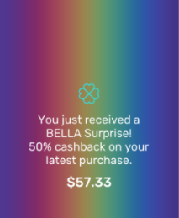
BLINK – BELLA SURPRISE
BELLA Surprise is when we reward you cashback bonuses on normal purchases—out of the blue, and completely at random. BELLA members use their BELLA debit cards as per normal—everything from a small purchase like a cup of coffee to larger purchases like plane tickets—but on occasion will see they’ve received bonus cashback.
Specs:
5% to 200%
Merchants with “vice” purchase and money transfers don’t apply.
Go directly to the checking account

Slide 9
Discretionary Fund - TBD
We give you the power to help our members when they need it.
Each agent will be allotted $1000 per month to assist with those unplanned situations.
EXAMPLES:
A member is filling up his gas tank but the money from his linked account hasn't come through, even though they have the Emergency Fund option you can decide to give that member the money needed to fill up their tank. Discretionary funds are gifts and do not need to be repaid.

Slide 10
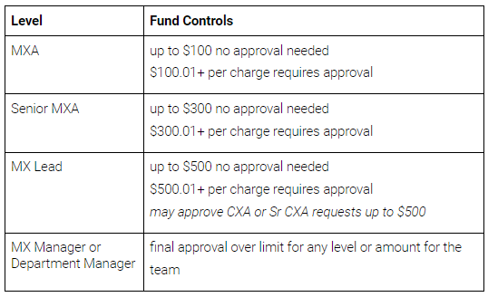
Discretionary Fund - TBD
Use of discretionary funds must be retained on a member’s account history by creating a case record for the use of funds. The case record must include: date of allocation, amount of funds provided, employee’s name and any approval records (as applicable), and a brief description of the purpose for the distribution.

Slide 11
CHECKING ACCOUNTS.
One account per member with no minimum balance to open and/or maintain.
One free physical debit card, delivered in 7-10 business days.
Non-interest bearing
You can link one external account to fund your Bella account (takes 3-5 business days),
Monthly statements available in the app.

Slide 12
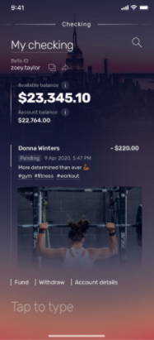
CHECKING ACCOUNTS.
Search transactions.
Bella ID
Can be used.
Hashtags to find your transactions easier.
Upload pictures to your transactions.
Send money to other Bella users with a personalized message.
No Overdraft.
$3,000.00/day transfer limit.
Includes pending amount.
Transaction details.
Account options.

Slide 13
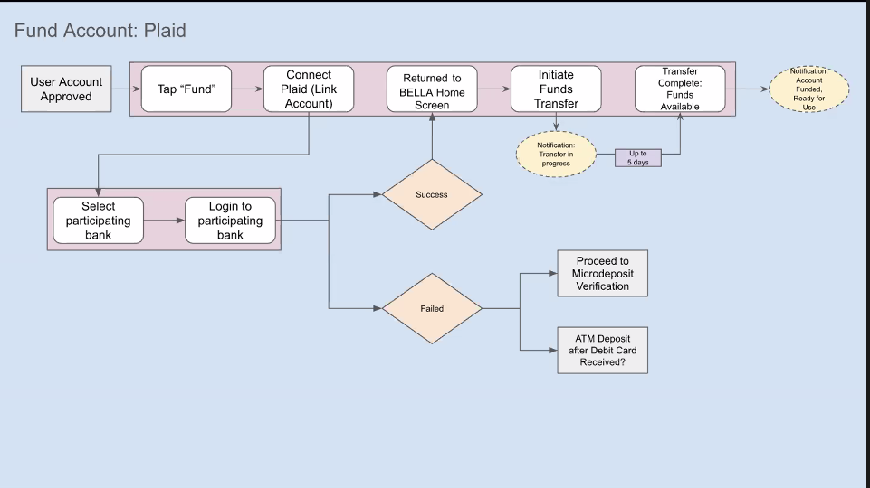
FUNDING YOUR ACCOUNT - PLAID

Slide 14
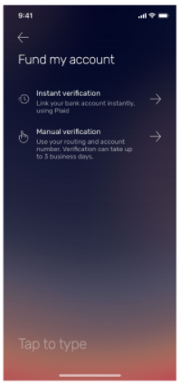
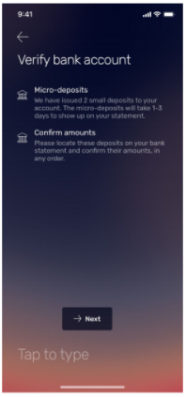
FUNDING YOUR ACCOUNT - MICRODEPOSITS
If a user’s bank isn’t supported by Plaid or if the user prefers not to link via Plaid, we can originate two microdeposits (<$1.00) into the external account that the user then needs to confirm to link the accounts. Then there is a withdrawal for the corresponding total.

Slide 15
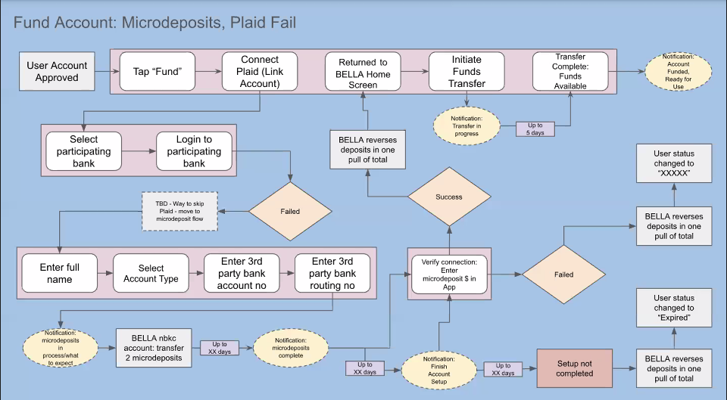
FUNDING YOUR ACCOUNT - MICRODEPOSITS

Slide 16
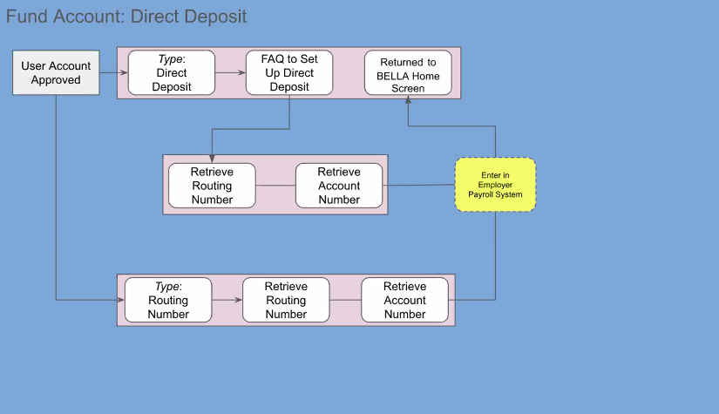
Funding your Account – Direct Deposit

Slide 17
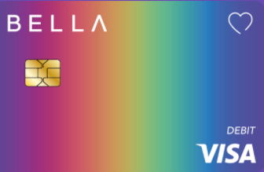
DEBIT CARD.
Dual-interface Visa Debit Card with contactless payments anywhere Visa is accepted
Apple Pay, Google Pay and Samsung Pay enabled
All card replacements are free (stolen or damaged cards one per year).
You can freeze/unfreeze your card in the app, without completely blocking it.
You can block your card in the app if you lose it. (Your account will not be blocked, only your card).
All our debit cards are made with recycled ocean plastic.
Limited edition card by artist: Jasper Wong. Availability TBD.

Slide 18
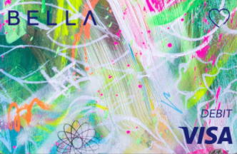
DEBIT CARD.
Can be used on any Visa ATM with no withdrawal fee.
$500.00/day in withdraws.
1% for foreign exchange conversion charged by Visa DPS. Reimbursed by Bella.
Recuring, international, and online payments allowed.

Slide 19
Card Activation.

Slide 20
SAVINGS ACCOUNTS.
Unlimited number of savings per member.
Up to $5MM insured by FDIC
0.20% APY (subject to change daily).
No minimal initial and or maintenance amount required.
Maximum of six withdrawals from each savings account per month.
You can be specific about your savings goals and set completion dates.
You can set conventional and unconventional (TBD) rules for funding your account.

Slide 21
SAVINGS ACCOUNT - DETAILS
Change picture.
Amount saved.
Manage goal.
Custom picture.
Add conventional rule.
Scroll down to see other SA.
Specific SA options.
General SA options.

Slide 22
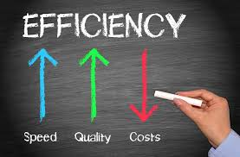
SERVICE LEVEL AGREEMENT
Maximizing your time. | Metrics | Description | Individual | Team
 | Online Rate | Time Agent is logged into CC (Online-Away-Back Soon) | 85% | 80%
 | Load | Avg load per Agent's Active/Inactive Convos | >85% | >80%
 | CCPLH | Closed Convos per logged hrs | >78% | >75
 | Active Rate % | % active convos over the total of convos | >78% | >75%
 | Agent Close Rate % | Closed Convos by the Agent | >45% | >40%
 | Auto Close Rate % | Closed Convos by the System - Autoclose | <35%
Responding to members | Average Response Time | ART | >2 mins < 10 mins | >3 mins <15 mins
 | Time to First Response | TTFR | <2 mins | <3 mins
 | CSAT | Customer Satisfaction (coming from the conversation - through post conv survey) | >86%
 | Meaningful Connection Score MCS | Automated real time measurement of member feelings | >30 | >28

Slide 23
WIDGET WALKTHROUGH

Slide 24
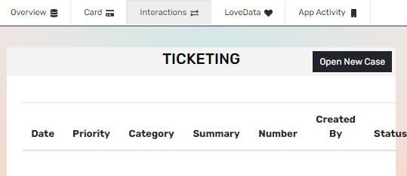
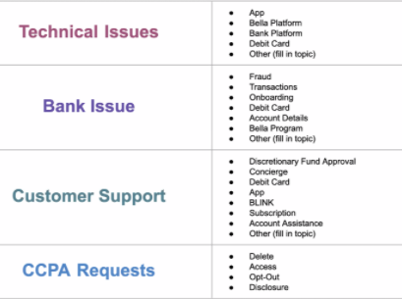
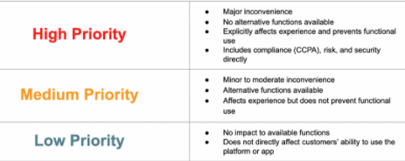
AW TICKETS - TBD

Slide 25
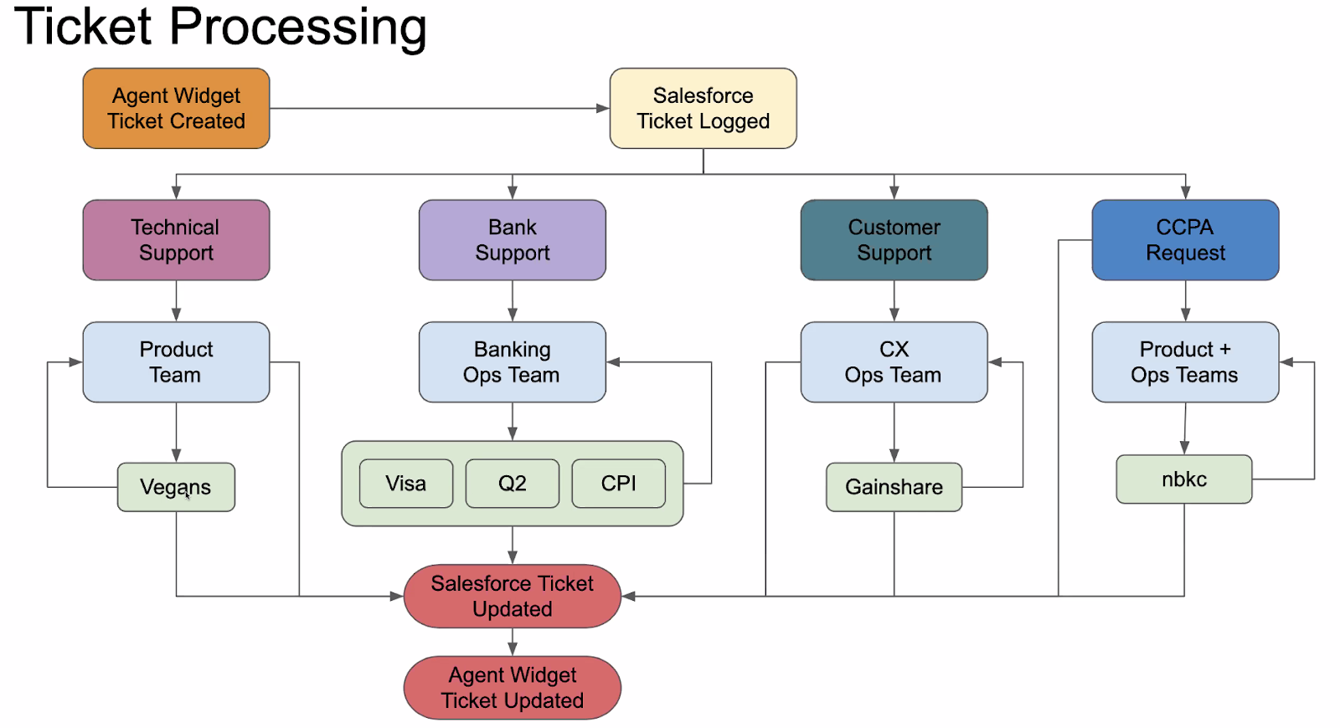

Slide 26
ACCOUNT CLOSING.
Checking: We’ll escalate, member has to come through App.
The money on the checking account needs to be taken out before we process the request.
Savings, and Karma: Done directly on the Bella App.
The money on the Savings and Karma account go automatically to your checking account.
Members don’t have to return their cards.

Slide 27
Thank you

